Slide 1
Advantages of migrating to…
CRM 2011
on premise -> on premise
Pablo Peralta
MVP Microsoft Dynamics CRM
Twitter: @pabloperalta
Blog: http://weblogs.asp.net/pabloperalta

Slide 2
New features CRM 2011
New navigation bar (ribbon)
Improved customization capabilities by advanced users
Highly improved Microsoft Outlook integration
In-line reports and graphs visualization
Flexible definition of dashboards
Interactive dialog forms to guide through an entire process
Flexible and native definition of goals and KPIs
Out-of-the-box integration with SharePoint 2010
Distribution of solutions and customizations

Slide 3

Advantages for…
…. the final user

Slide 4
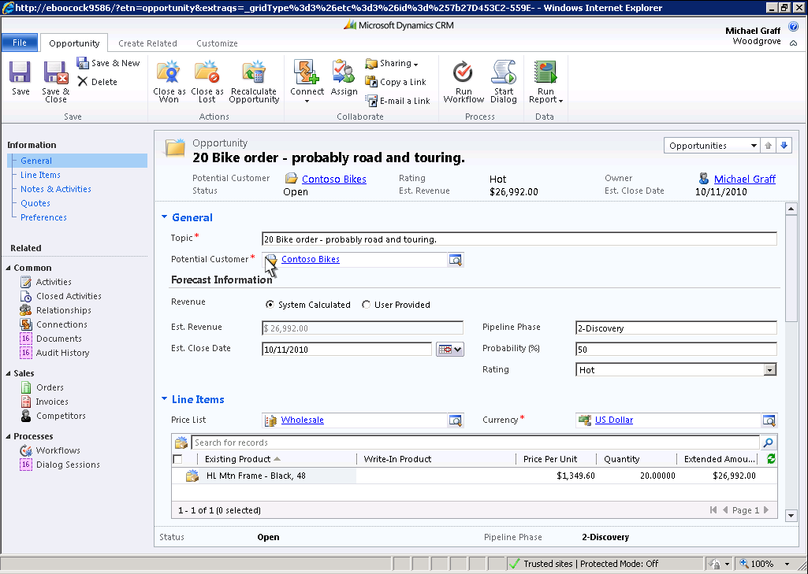
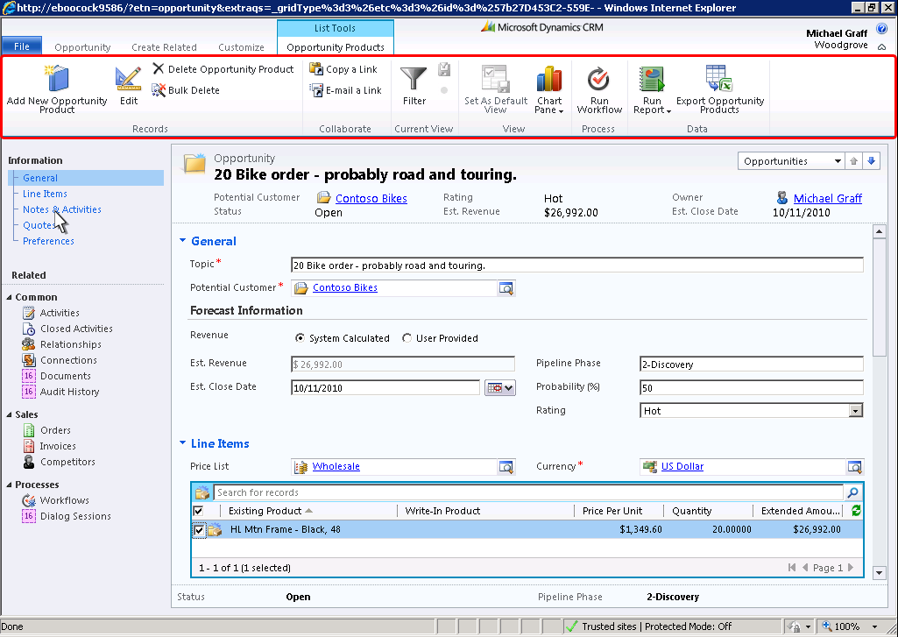
New navigation bar

Slide 5
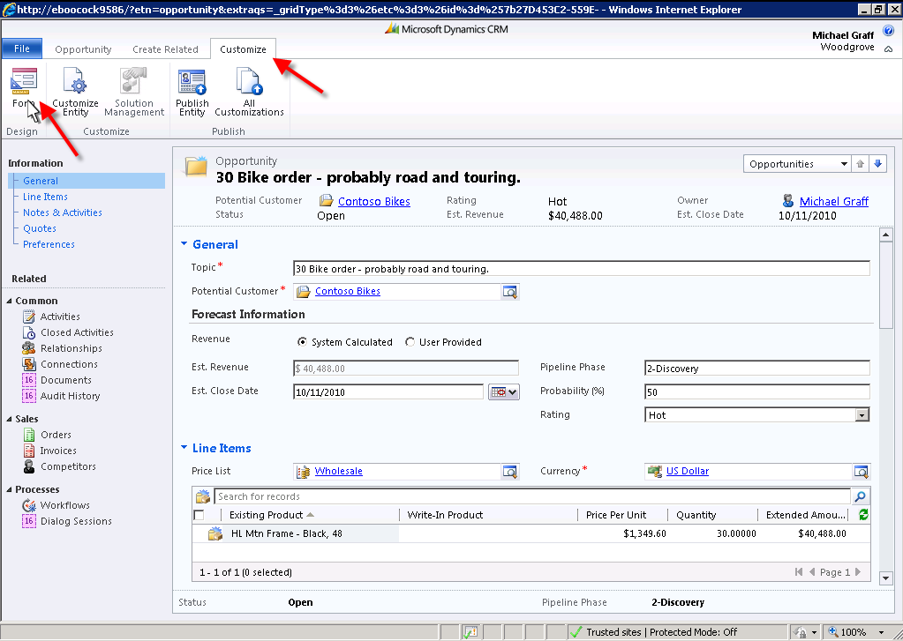
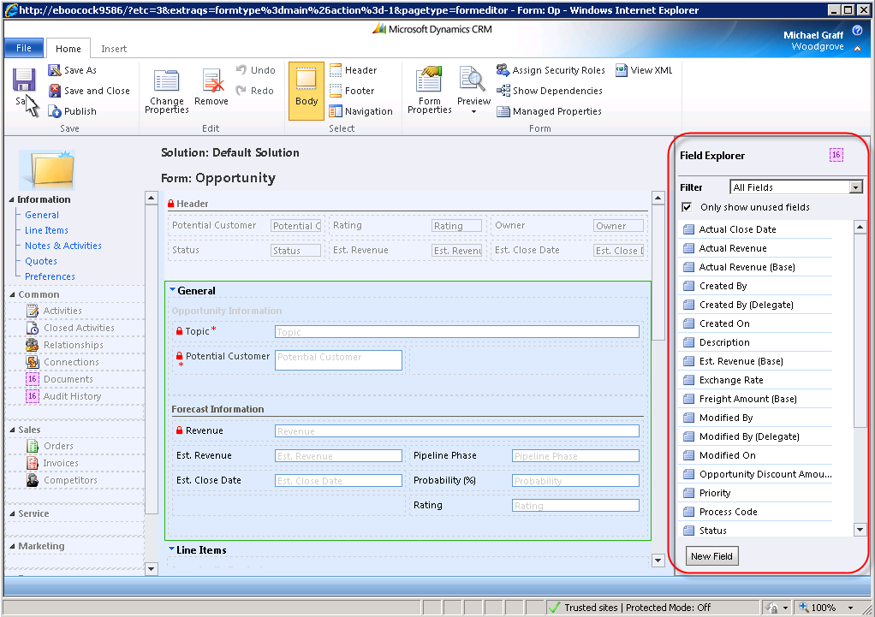
Advanced user customization

Slide 6
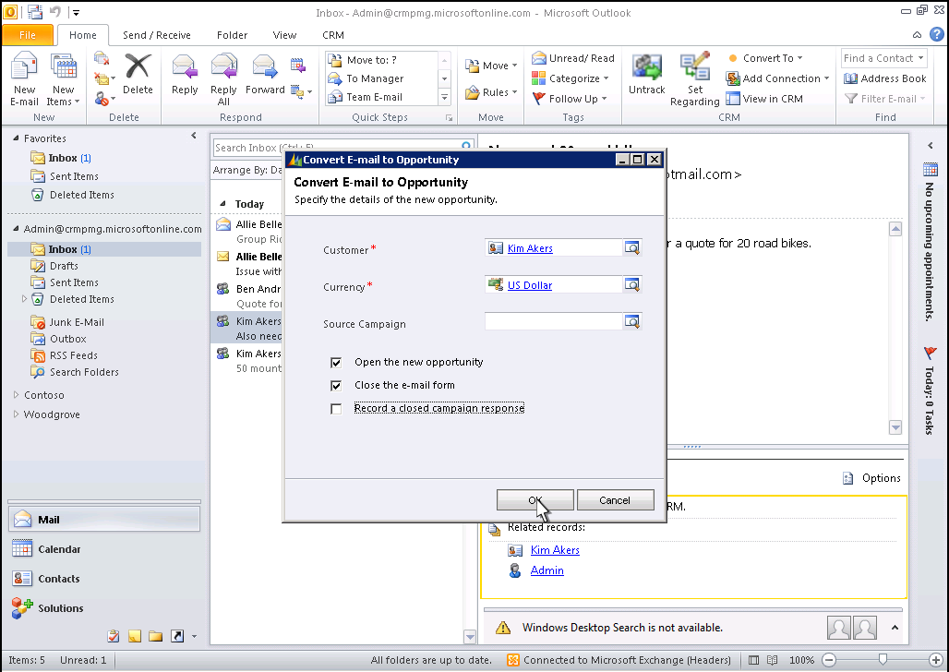
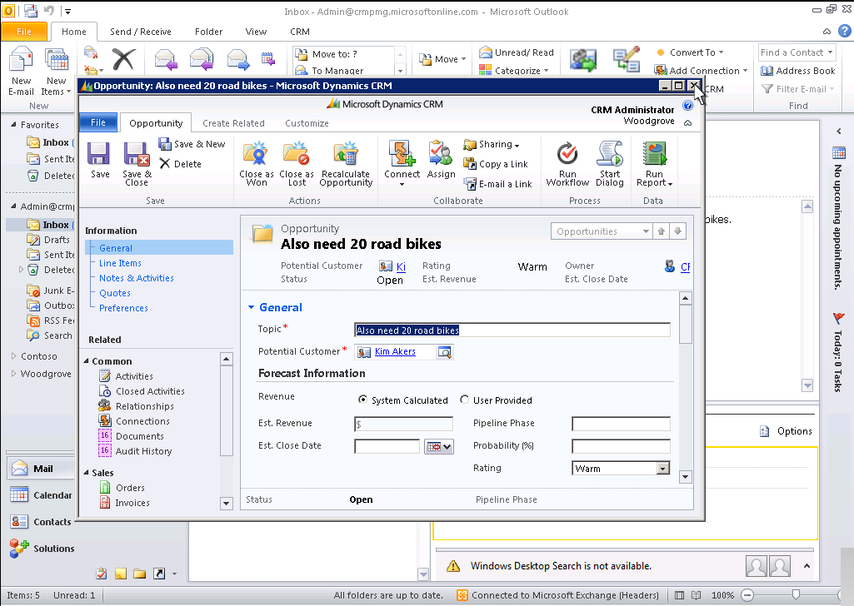
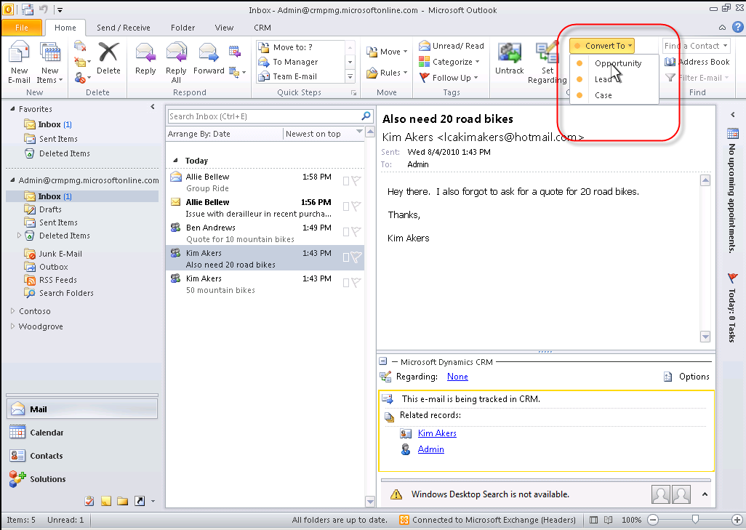
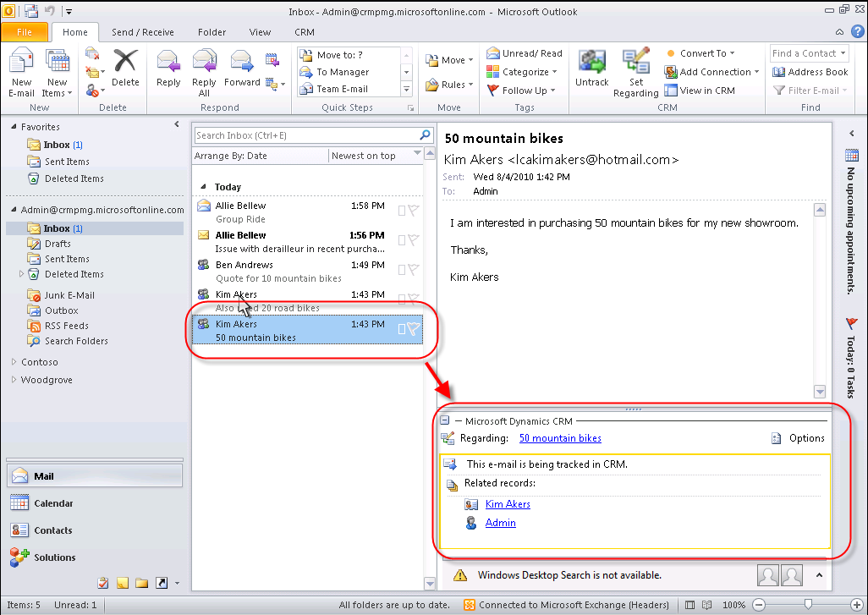
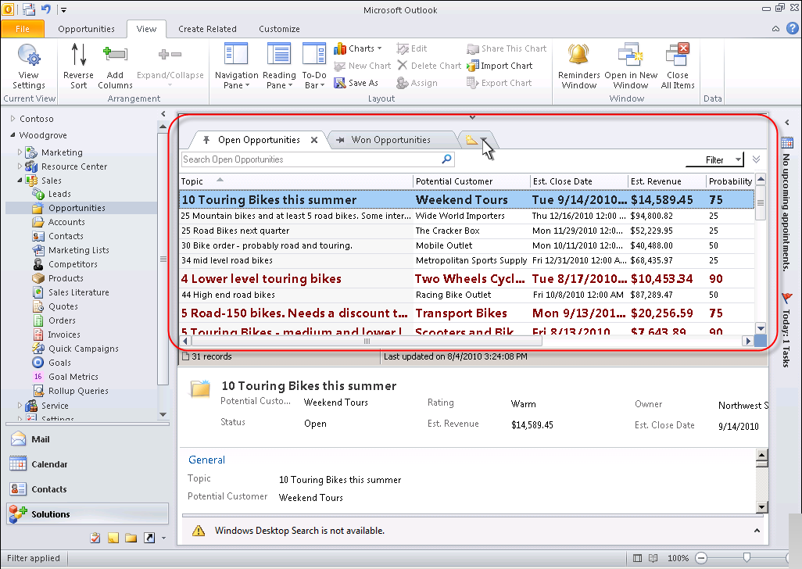
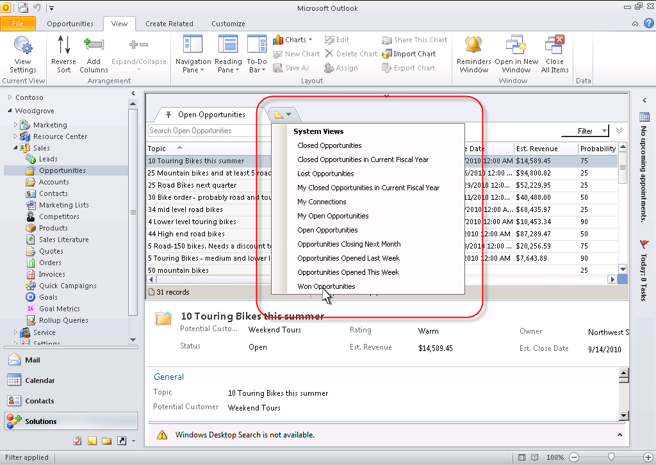
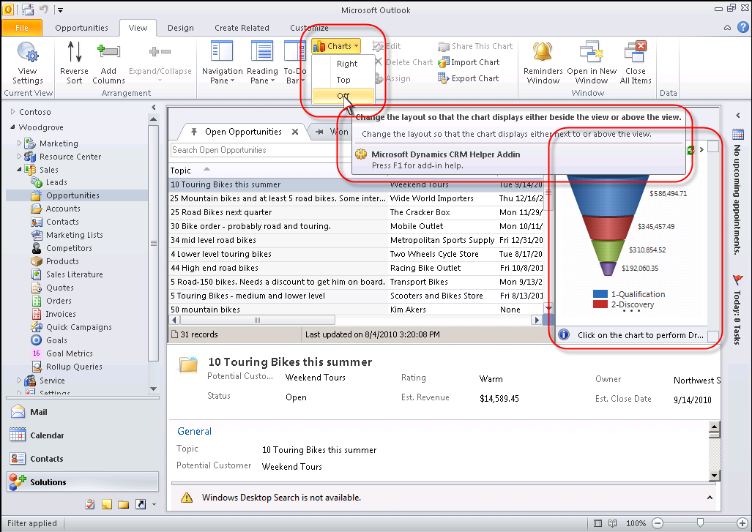
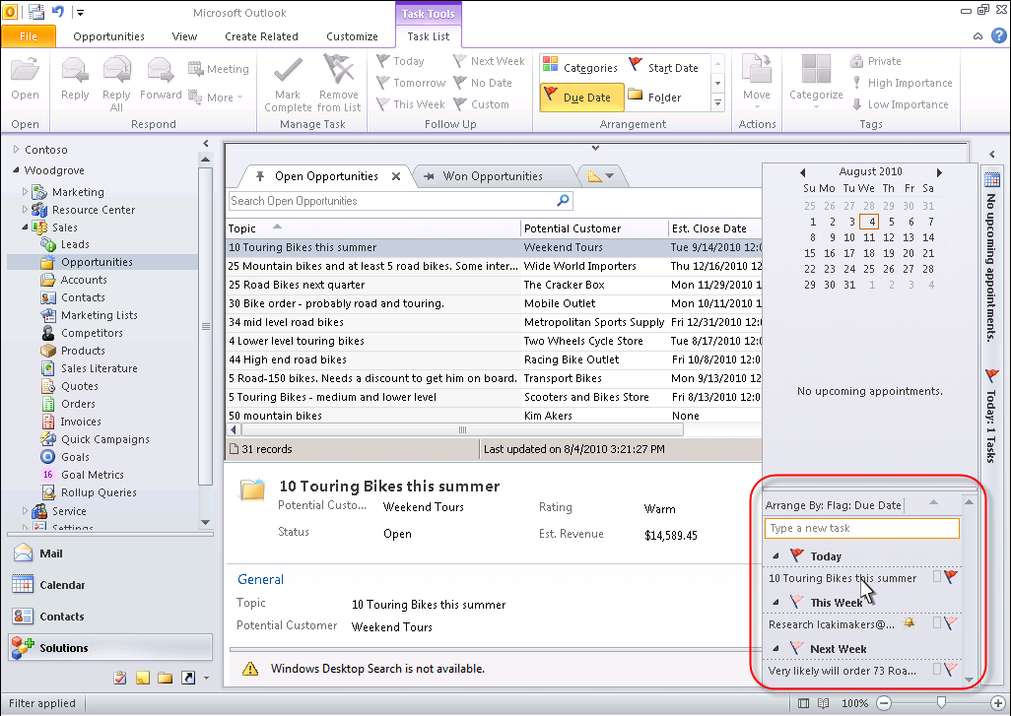
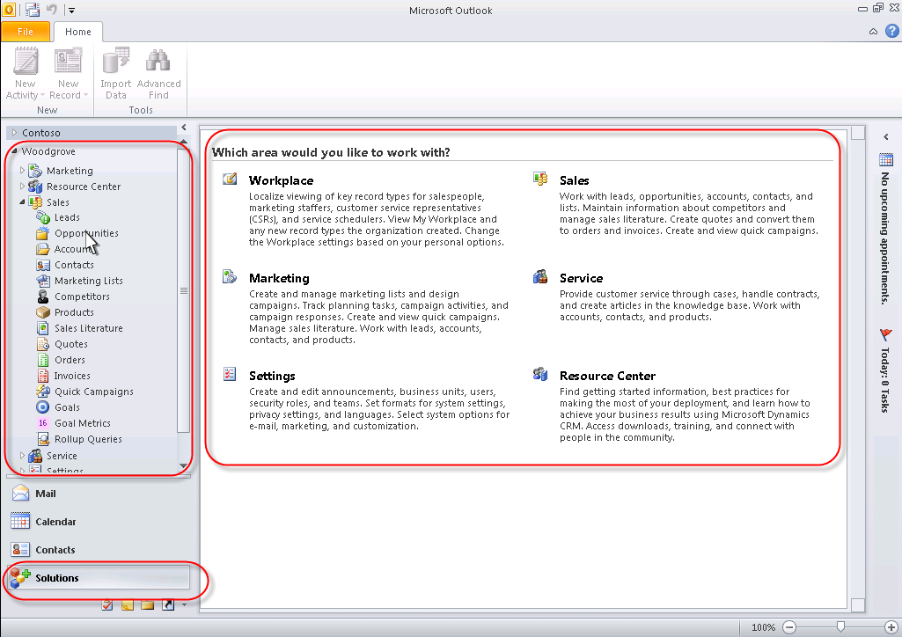
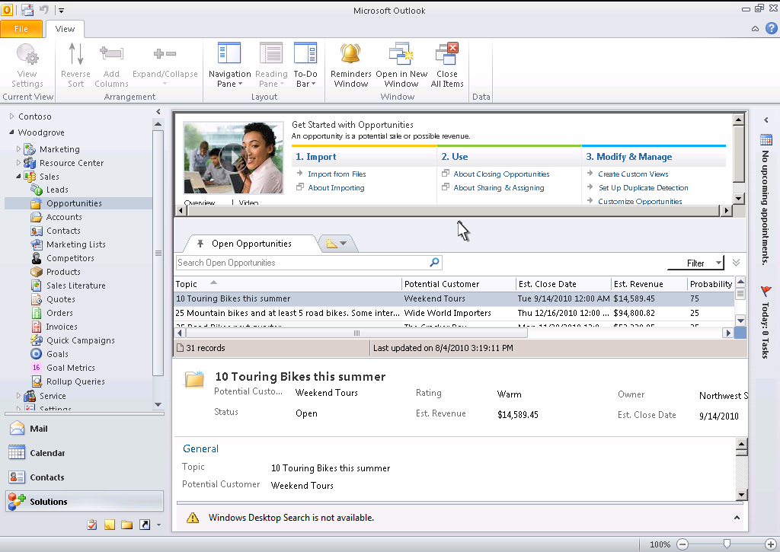
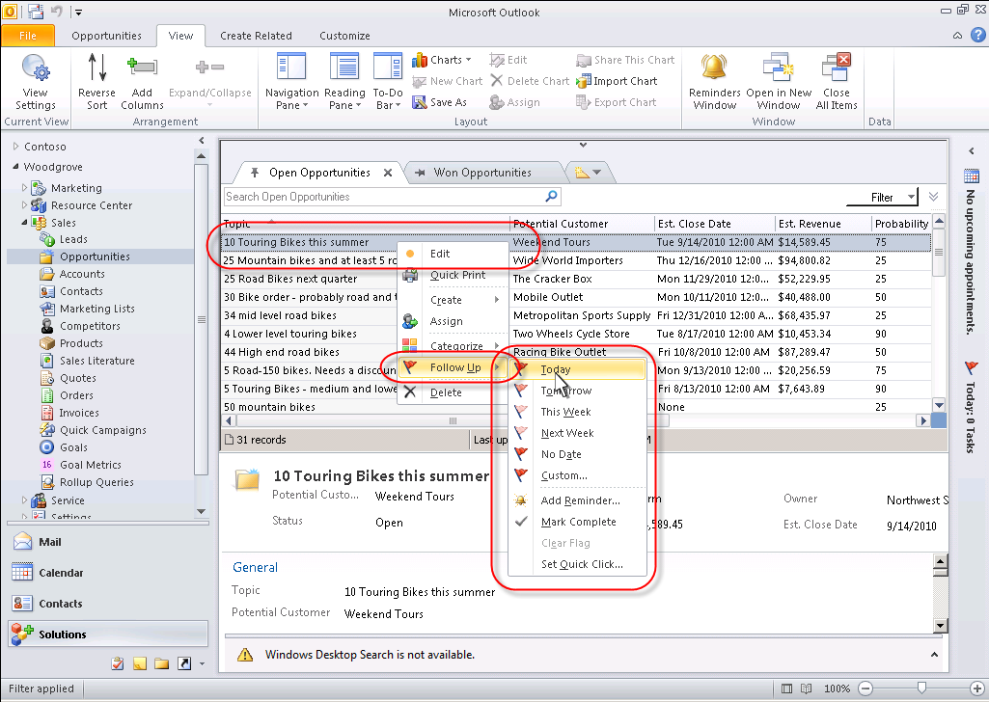
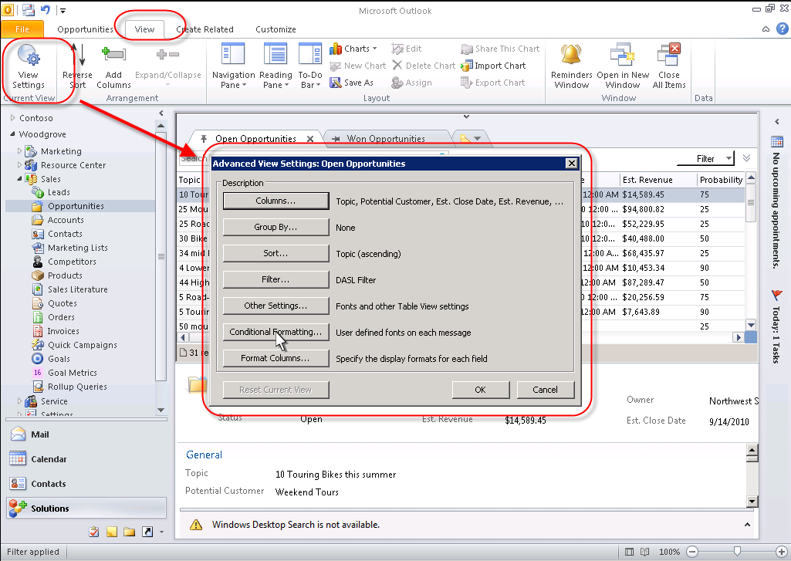
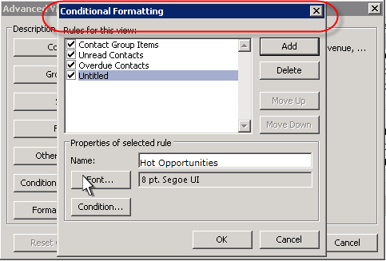
Highly improved Microsoft Outlook integration

Slide 7
Advantages for…
…. analysts & business decision makers

Slide 8
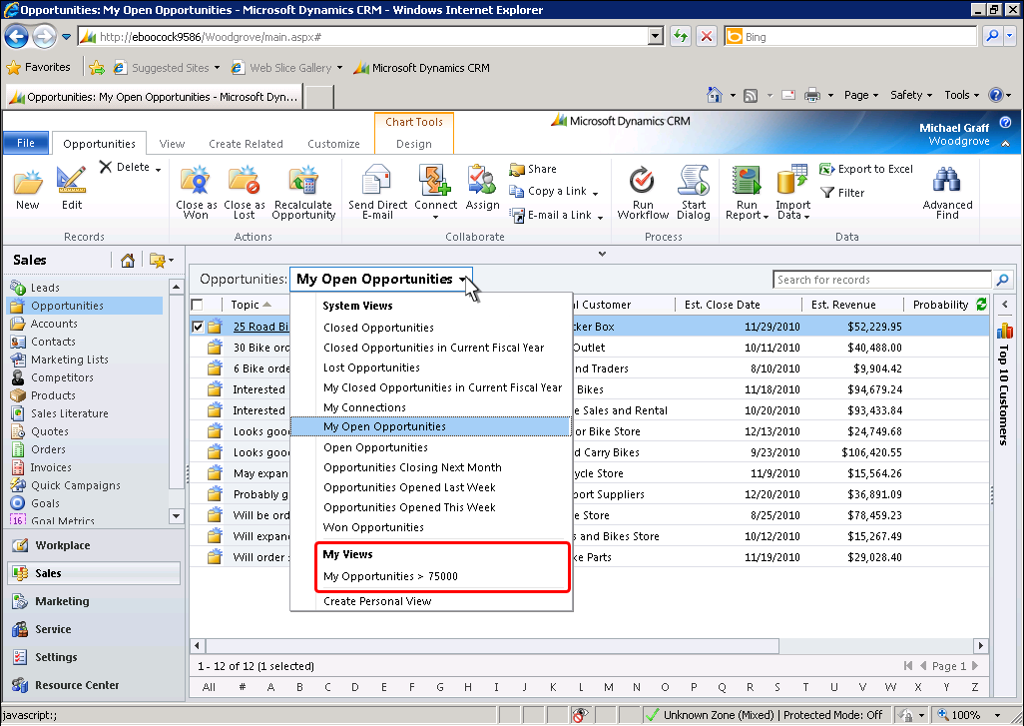
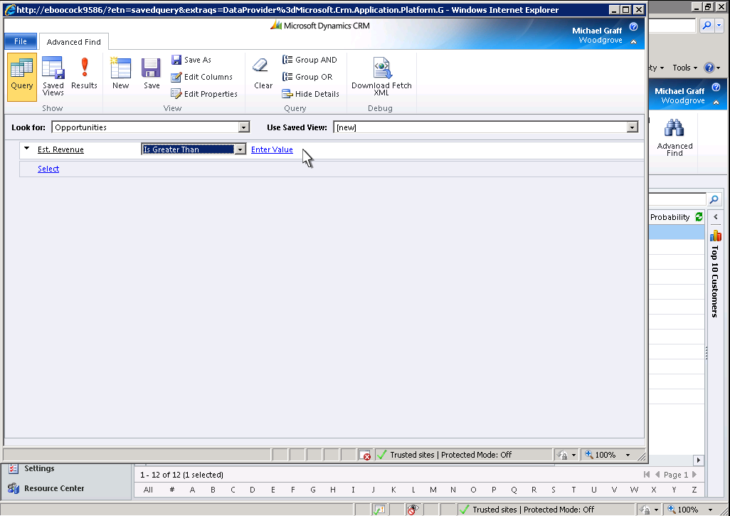
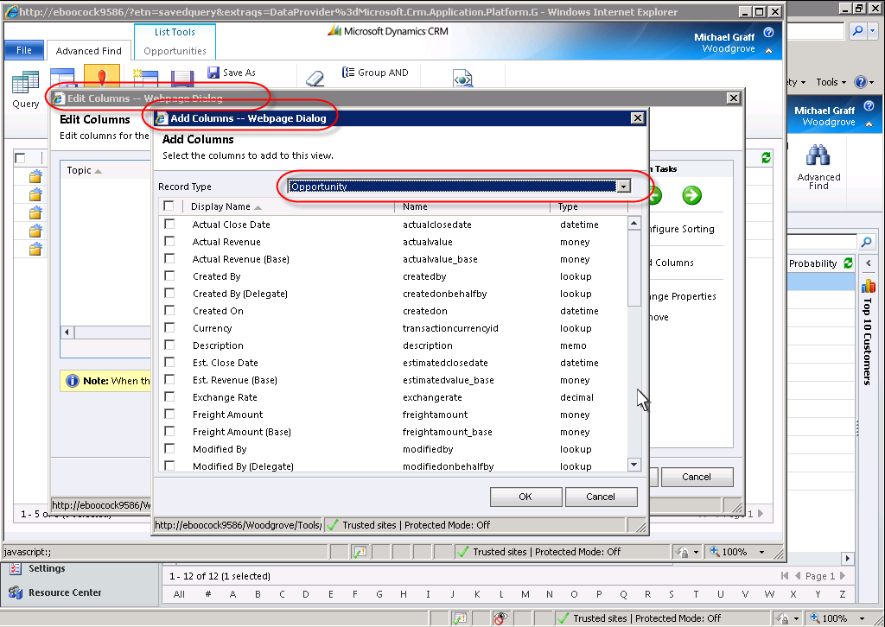
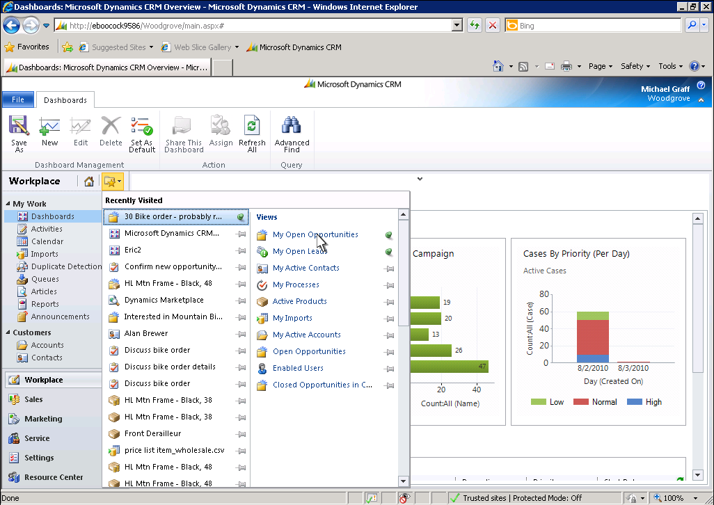
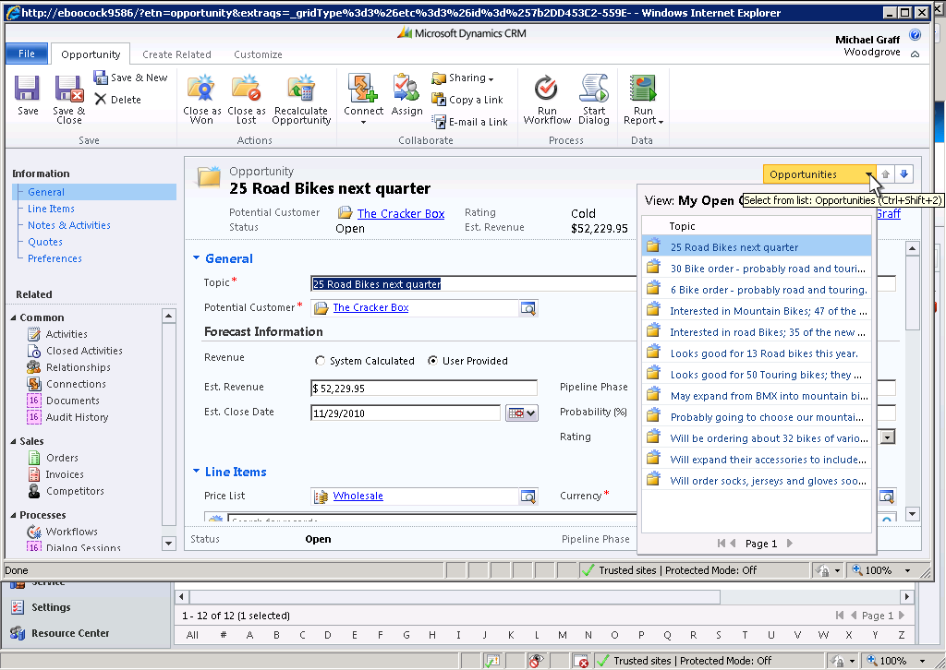
In-line visualization of reports and graphs

Slide 9
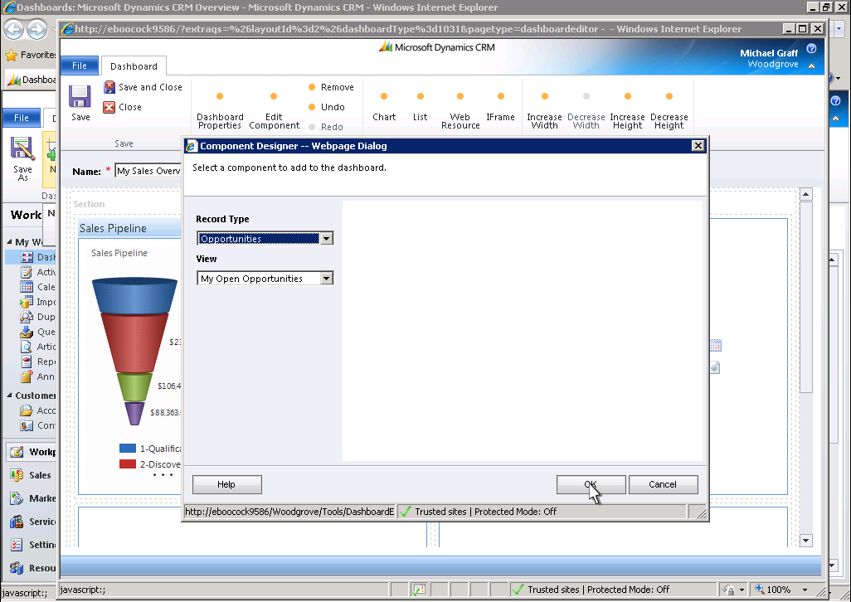
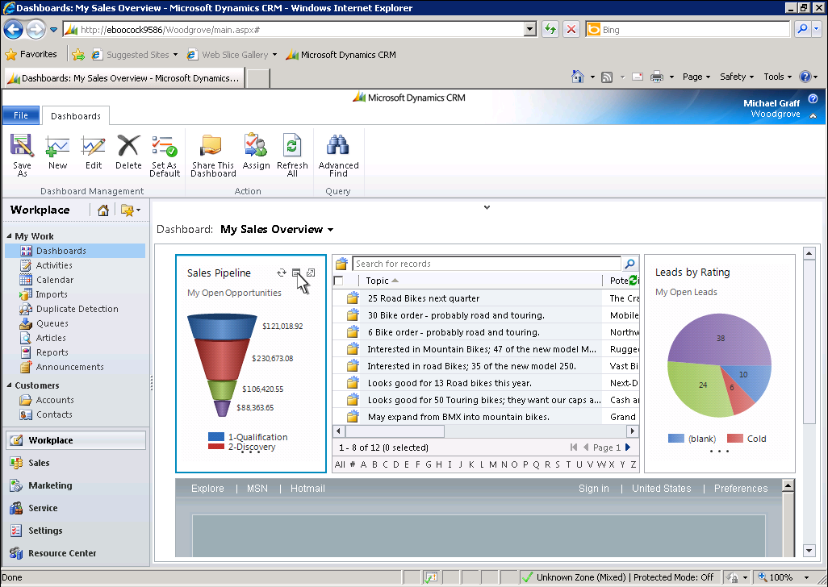
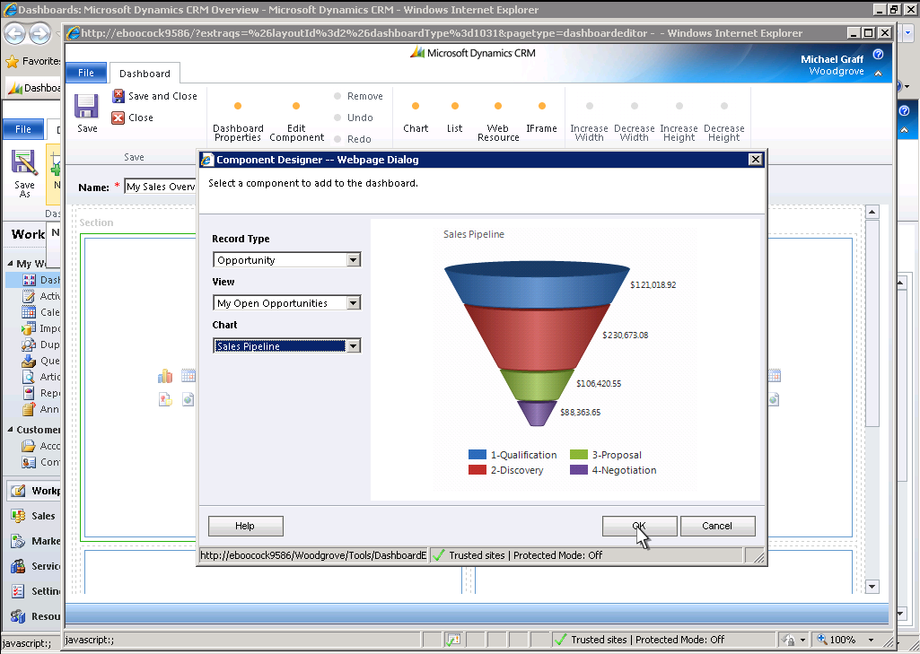
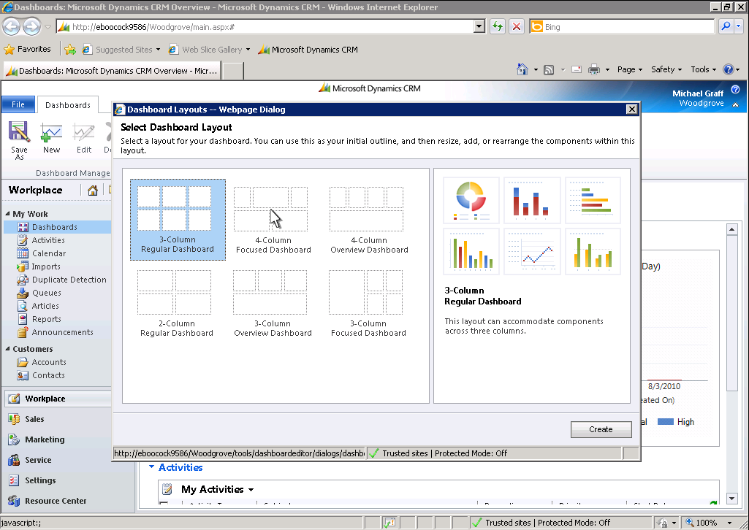
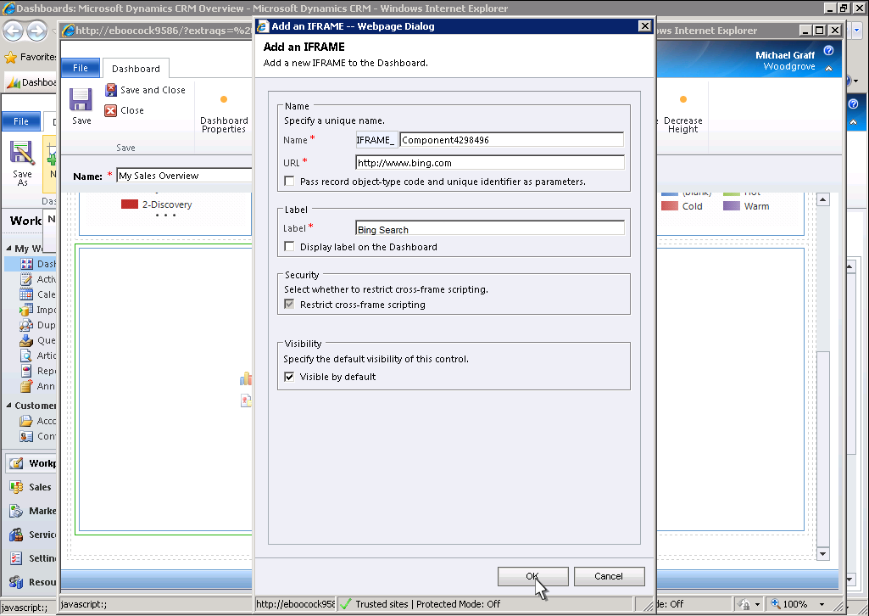
In-line dashboards

Slide 10
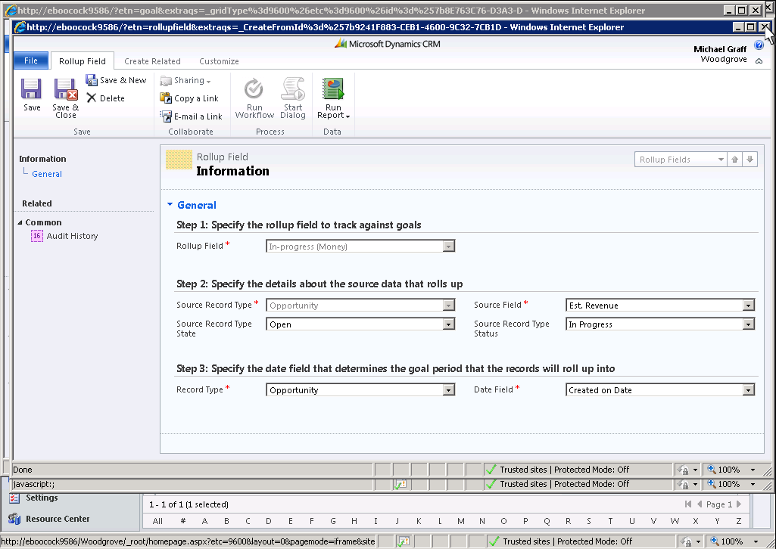
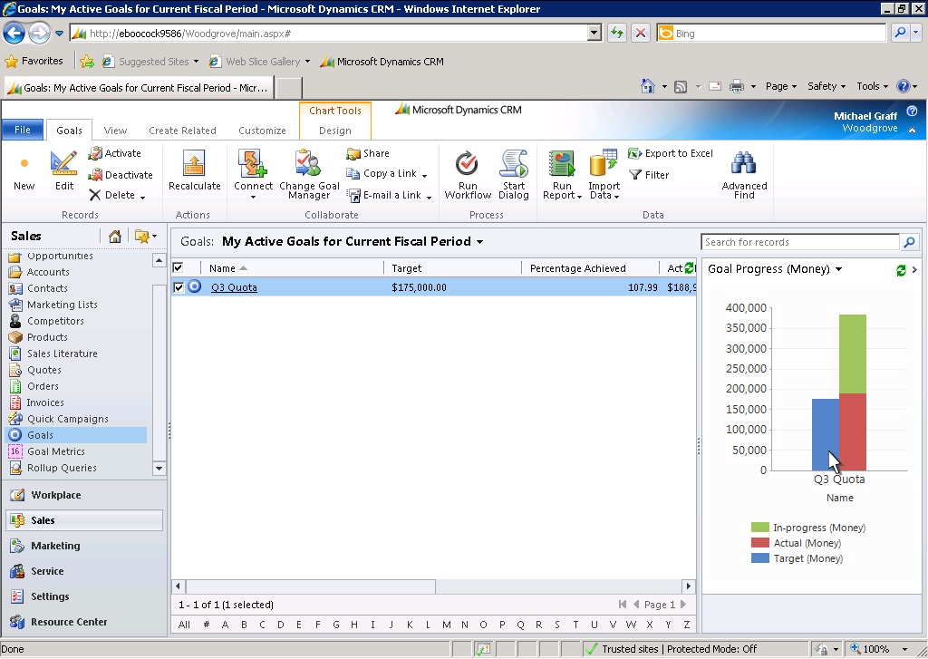
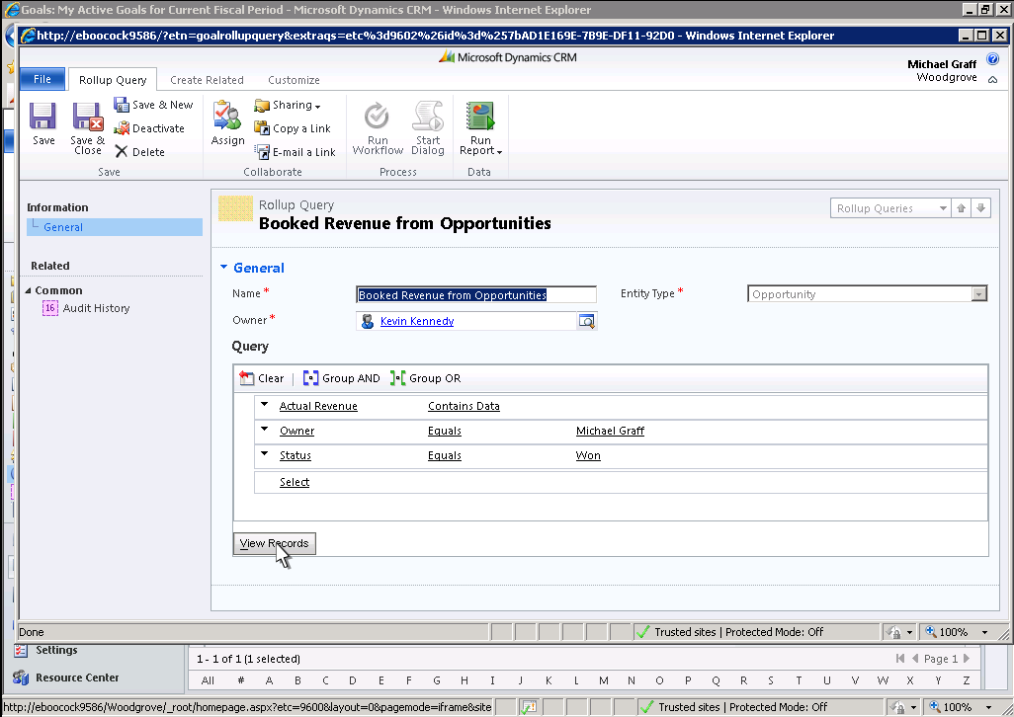
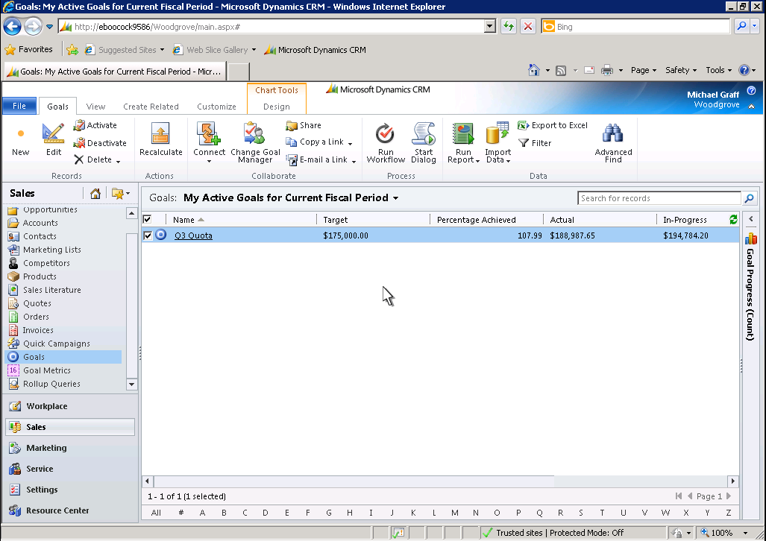
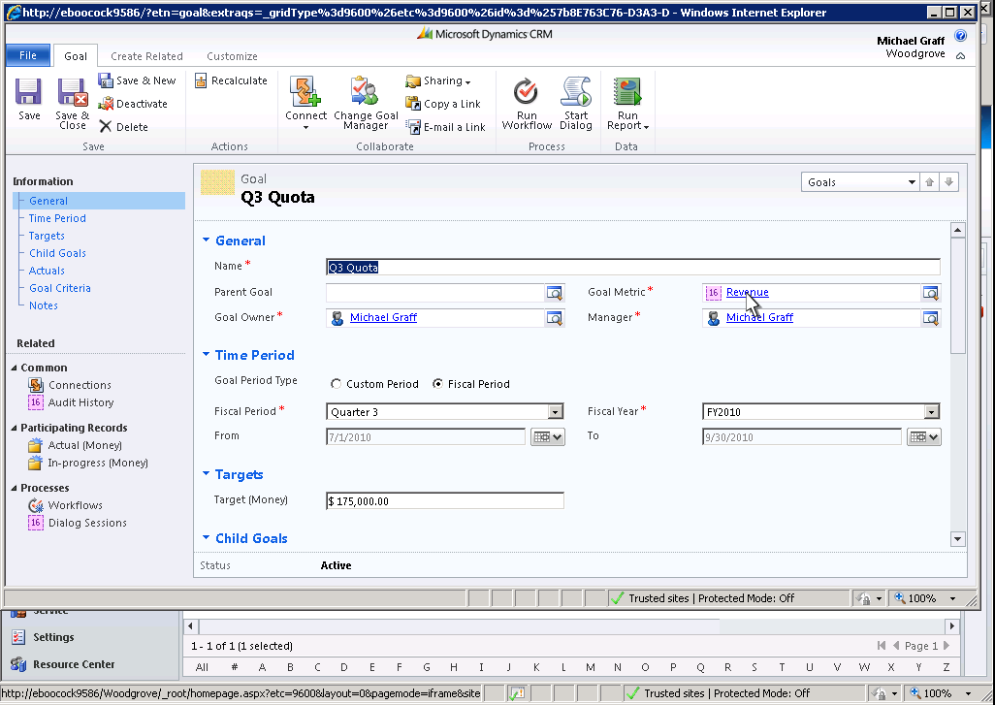
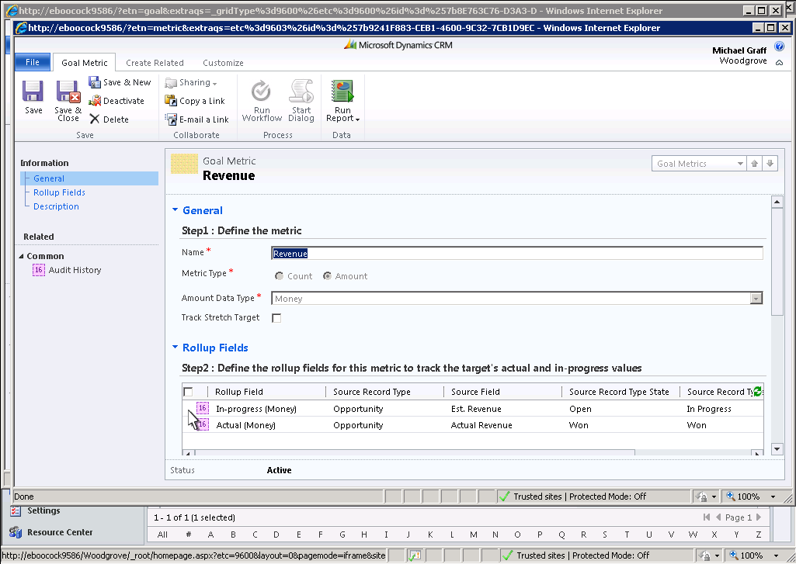
Flexibile and native definition of goals and KPIs

Slide 11
Advantages for…
…. customizers & developers

Slide 12
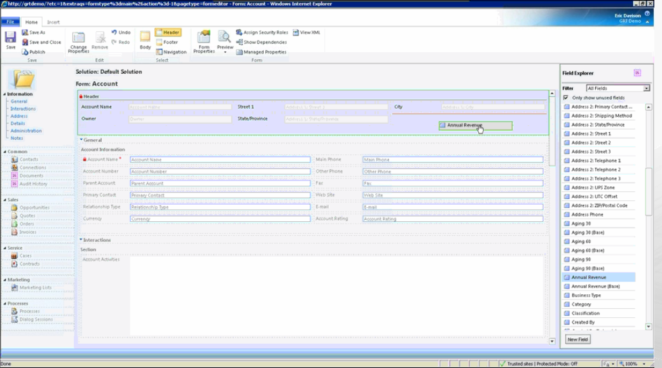
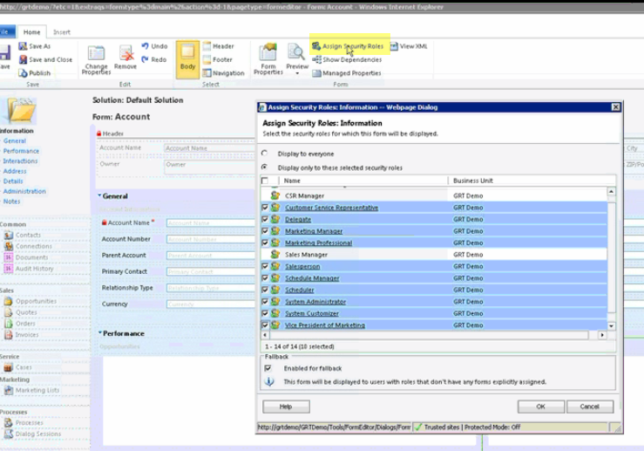
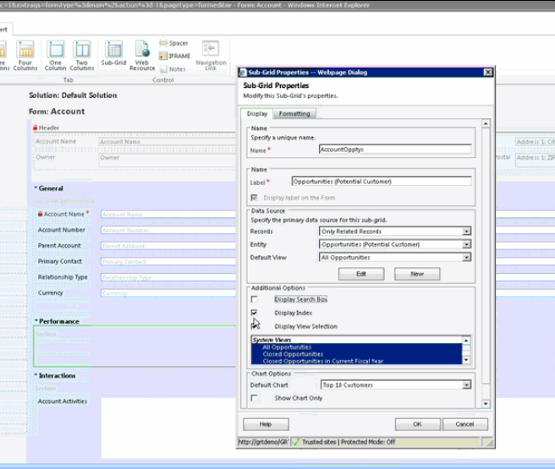
New form designer

Slide 13
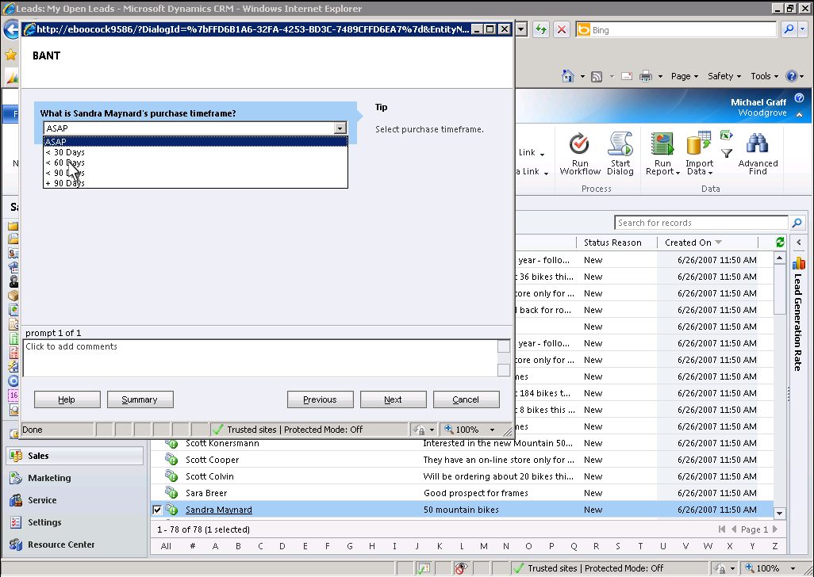
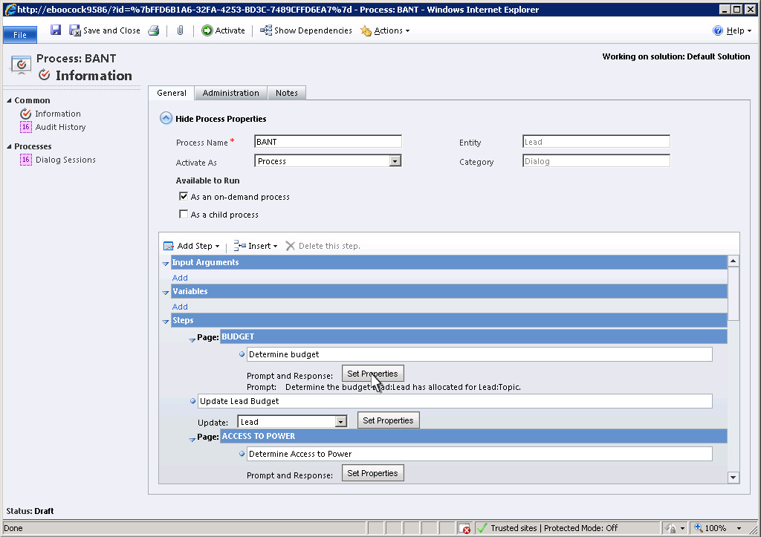
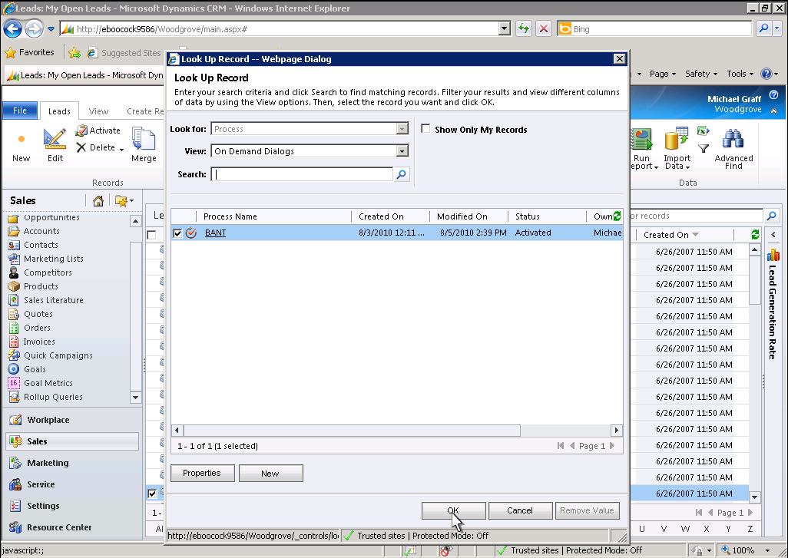
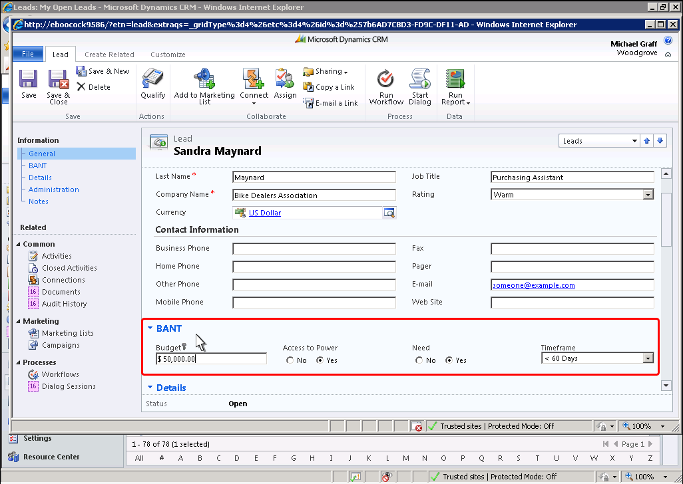
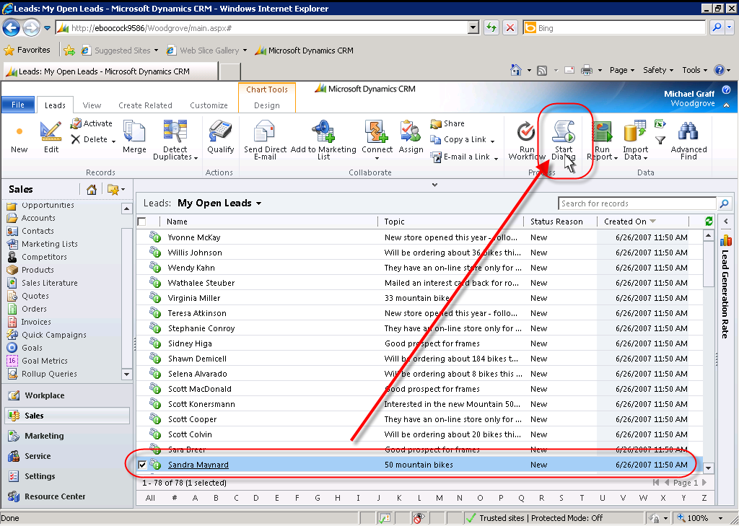
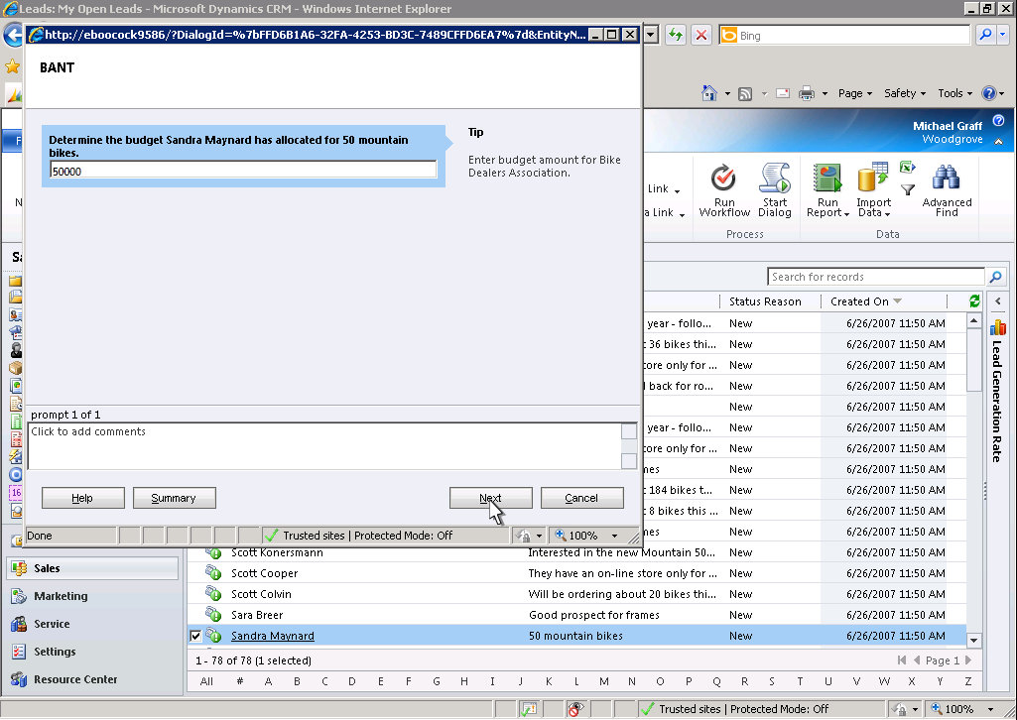
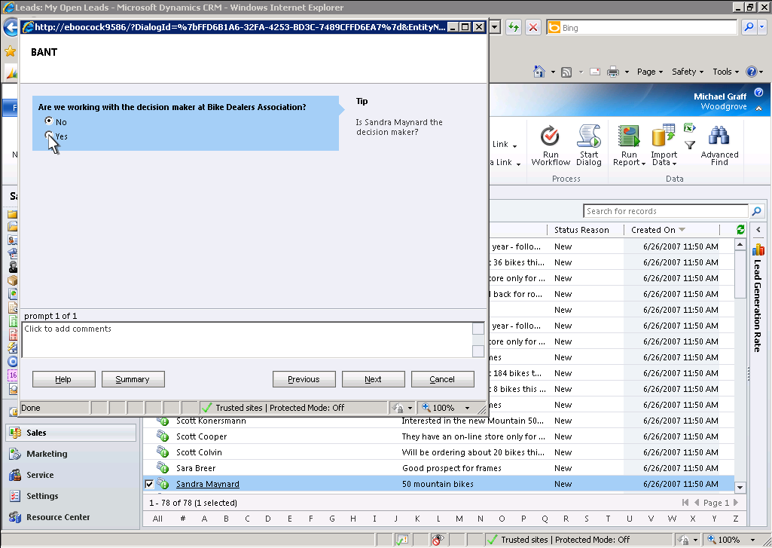
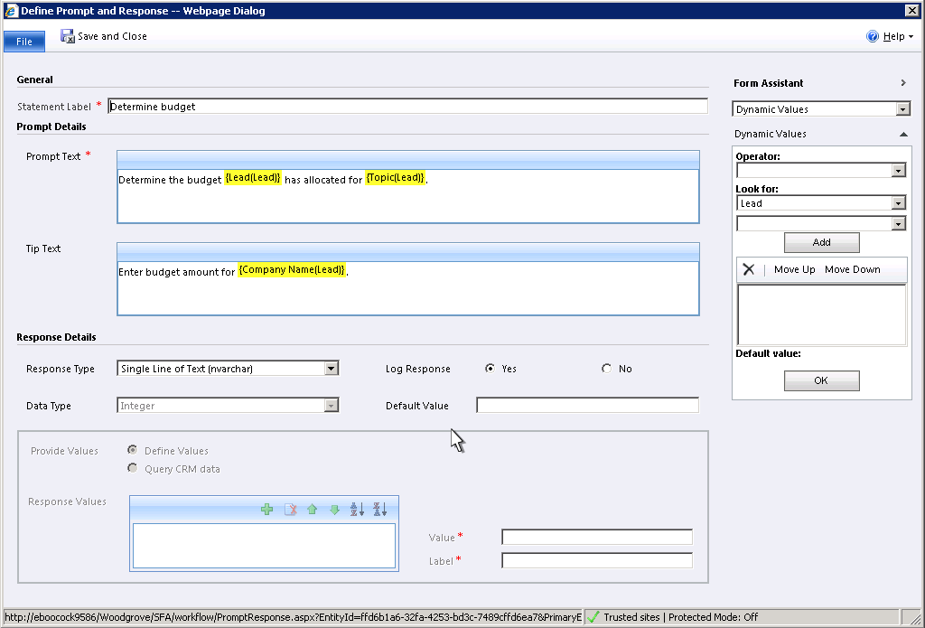
Interactive dialogs with the final user

Slide 14
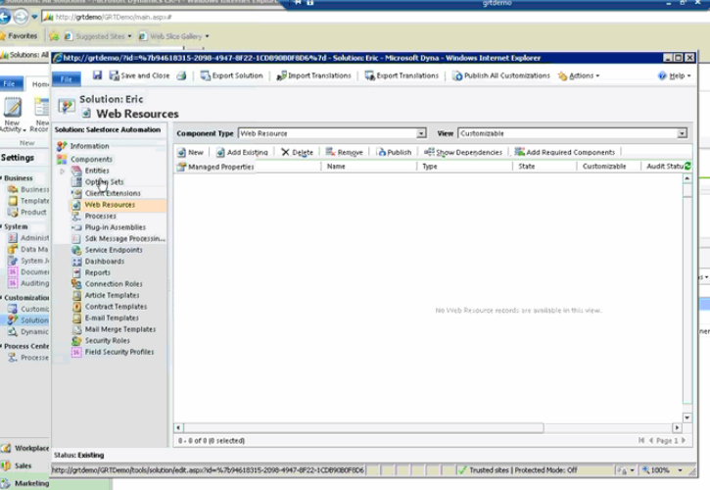
Concept of ‘Solution’

Slide 15
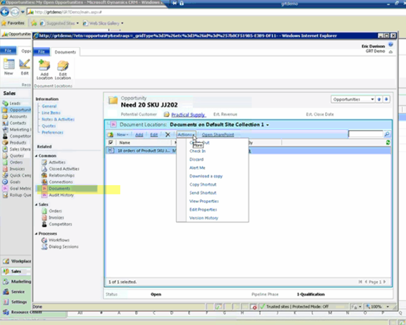
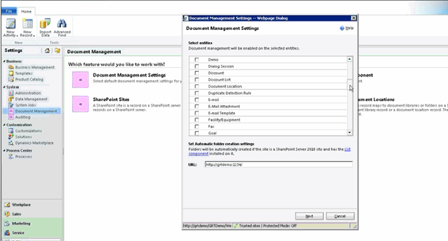
Out of the box integration with Sharepoint 2010

Slide 16
Requisites…
CRM 4.0
Server
  Windows Server 2003/2008
  Active Directory
  SQL Server 2005/2008
  IIS
  .Net Frmk 3.0
Client
  Windows XP/Vista/7
  IE 6/7/8
  Office 2003 / 2007
  SQL Express (Offline Access)
  .Net Frmk 3.0
1 installation, N organizations
(only Enterprise edition)
CRM 2011
Server
  Windows Server 2008/2008R2
  Active Directory
  SQL Server 2008/2008R2
  IIS
  .Net Frmk 4.0
  x64 [64 bits]
Client
  Windows XP/Vista/7
  IE 6/7/8
  Office 2003 / 2007
  SQL Express (Offline Access)
  .Net Frmk 4.0
1 installation, N organizations

Slide 17
Questions?
Gracias.
Pablo Peralta
MVP Microsoft Dynamics CRM
Twitter: @pabloperalta
Blog: http://weblogs.asp.net/pabloperalta

